Slide 1


How to collect the first 10 or every 4th event ?
Taiob Ali

Slide 2
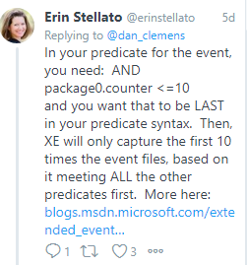
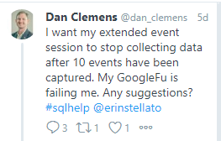

Slide 3
Predicate
Global
Predicate Source
Local
Event Field

Slide 4
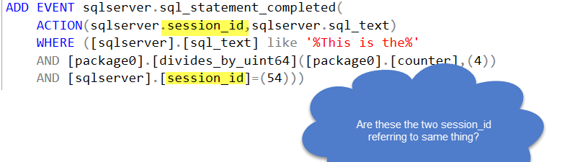
Check if Action Enabled
Collect EventData
Analyzed Predicate
Collect Action Data
Publish

Slide 5
package_name.pred_compare(field/pred_source, value)
package0.divides_by_uint64(package0.counter,4)

Slide 6
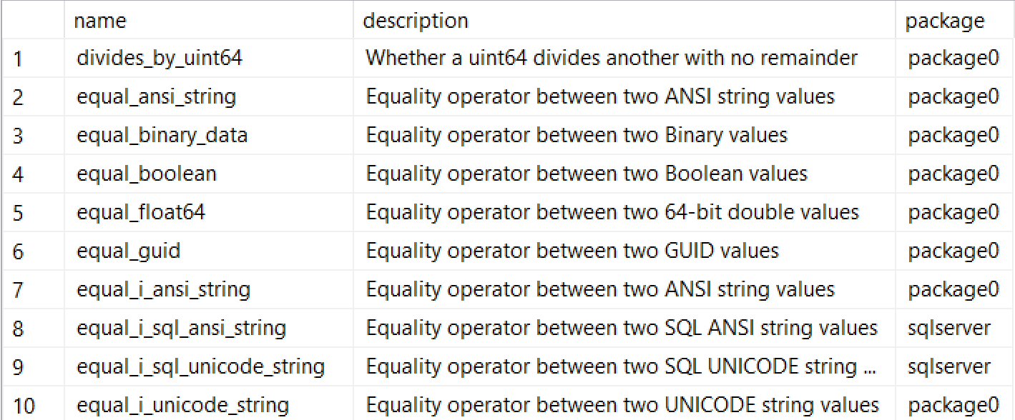

Slide 7


Slide 8
Resource
Try a sample: Using the counter predicate for event sampling
Today’s Subject: Predicates
Reading event data 101: What’s up with the XML?
Why I hate the ring_buffer target in Extended Events

Slide 9
Work
Outside Work
Giving Back
Running—One 26.2 and Many 13.1
Frequent speaker local user groups, SQL Saturdays & Virtual groups
Blog at sqlworldwide.com
13 years as DBA
10 years in Merchant Marine
MCSE Data Management and Analytics
Answering questions at #sqlhelp & dba.stackexchange
Shuttling 3 kids
Co-organizer NESQL User Group

Slide 10





@SqlWorldWide
linkedin.com/in/taiobali
sqlworldwide.com
taiob@sqlworldwide.com

Slide 11


